Slide 1
Maimonides
Dr. Stephanie Spoto
4/4/2019
Monterey Peninsula College
Gentrain 406: The Medieval Renaissance and the High Middle Ages

Slide 2
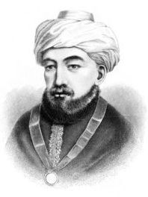
Maimonides
Sephardic Jewish philosopher → from the Sepharad region of Spain
Became one of the most prolific scholars of Jewish theology and the Torah in the middle ages
Born to established family in Cordoba, and worked variously as a rabbi, physician, and philosopher in Egypt and Morocco

Slide 3
Golden Age of Jewish Culture in Spain
Coincided with the Middle Ages in Europe
Period of Muslim rule in much of Spain and Portugal during which Jews were generally accepted into society
Jewish religious and cultural life flourished.
Debate over nature and length:
  Many scholars debate the validity of conceptualizing a continuous Golden Age → several periods when non-Muslims experienced oppression
  Some see beginning of Golden Age with Muslim conquest of Iberia: c. 711 → others see it as beginning of the rule of Abd-ar-Rahman III (religious freedom)

Slide 4
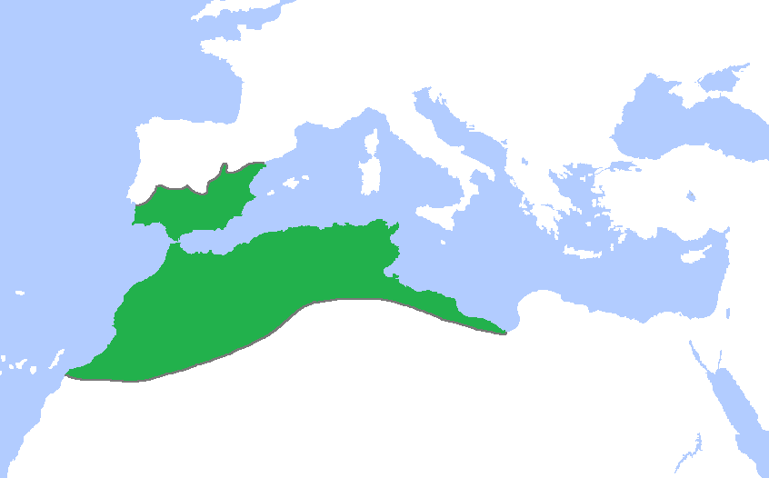
The end: Some say it ended in 1066 with the Granada massacre (targeted Jewish population), others say it ended when the Almohad’s invaded in the middle of the 12th century.

Slide 5
Almohad invasion and Maimonides
Young Maimonides studied theology with his father, and was known for having a keen intellect
Tolerance of Muslim Spain destroyed with the ascension of the Almohad (“Unitarians), who captured Cordoba in 1148
Maimonides continued to study the Torah in secret with his father, but in public the pretended to be Muslim converts

Slide 6
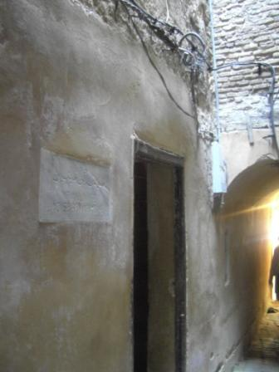
Maimonides’s family wanderings
This first exile from Spain was the beginning of many wanderings for his family
Moved to Fez in Morocco where they thought they would be safe, but after the execution of Maimonides’s teacher, the moved again to Palestine and then finally to Egypt, near Cairo
Brother dies in a shipwreck with all the family’s fortunes. Maimonides takes up medicine as profession to support family

Slide 7
Philosophy
Guide for the Perplexed, important work → commentaries on the Mishna (the oral Torah – oldest post-Biblical collection of Jewish law)
Had influence outside sphere of medieval Jewish philosophy, especially on the Scholastic philosophers, like Thomas Aquinas.
Studied Arabic philosophy and Aristotle → worked to reconcile Aristotilean philosophy and science with the teaching of the Torah
Guide for the Perplexed→ works to explain the purpose and function of the statutory provisions contained in the Torah within their historical context.

Slide 8
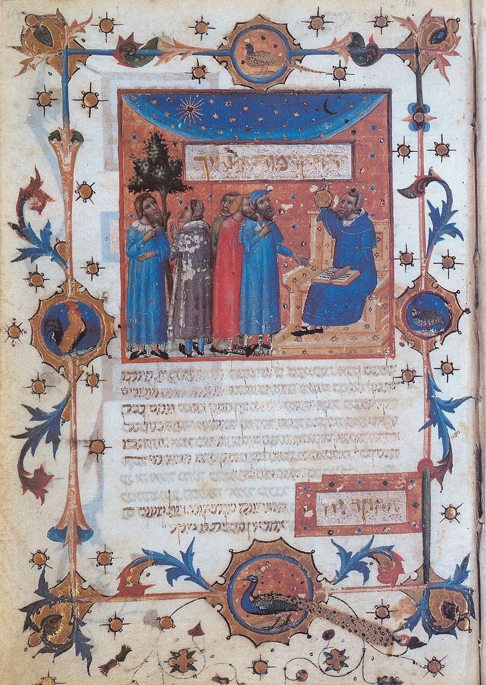
A page from a 14th-century manuscript of the Guide. The figure seated on the chair with Stars of David is thought to be Aristotle.

Slide 9
The purpose of the Guide
... “to enlighten a religious man who has been trained to believe in the truth of our holy Law, who conscientiously fulfills his moral and religious duties, and at the same time has been successful in his philosophical studies”.
“This work has also a second object in view: It seeks to explain certain obscure figures which occur in the Prophets, and are not distinctly characterized as being figures. Ignorant and superficial readers take them in a literal, not in a figurative sense. Even well informed persons are bewildered if they understand these passages in their literal signification, but they are entirely relieved of their perplexity when we explain the figure, or merely suggest that the terms are figurative. For this reason I have called this book Guide for the Perplexed”

Slide 10
God is a necessary being
God of Abraham is what philosophers refer to as the Necessary Being.
God is unique in the universe, and we must love and fear God because of that uniqueness (Deut 10:12).
Contemplate God’s works, wonder at the order and wisdom of their creation → one loves God and sees their own insignificance in comparison to God
Aquinas → God is necessary → contingent existences → the non-existence of God is an impossibility
Maimonides’s principle of God as Necessary Being was the same principle that was fundamental to scholasticism → there can be no contradiction between God’s revealed truths and the discoveries of the human mind in philosophy and science.
Reflected on science of Aristotle and teaching of Talmud → the basis of Aristotle’s science can be found in the Talmud

Slide 11
Negative Theology
Admired the Neoplatonists and this led him to “negative theology”, which the Scholastics did not accept.
Negative theology: describing God by what he is not
For example: rather than saying that God exists, we must say that God is not non-existent. Rather than saying that God is wise, we should say that God is not ignorant.
God is one? → Better: “there is no multiplicity in God’s being” → However, this is a way of knowing God that many did actually turn to (like Aquinas)

Slide 12
God as Human-like?
God is not corporeal → central to his thinking about the sin of idolatry.
Anthropomorphic phrases pertaining to God in sacred texts should be interpreted metaphorically
Draws a distinction between true beliefs (beliefs about God that produced intellectual perfection) and necessary beliefs (conducive to improving social order).
  Anthropomorphic personification statements about God in the latter class (necessary beliefs).
  Claim: God becomes "angry" with people who do wrong. Maimonides (via Avicenna): God does not become angry with people, as God has no human passions; but it is important for them to believe God does, so that they desist from doing wrong

